Slide 1
Load security on different
Super-structures
The European project ICT-DRV
online training course “Load Security”

Slide 2
Requirements on superstructures
What is transported?
How is the good packed?
What quantity is transported?
What external conditions need to be considered?
What transport routes are planned?

Slide 3
Superstructures
Curtainsider/
Curtainsider „Code XL“
Box
(with or without side doors)
Open flat
Cover/ Stake

Slide 4
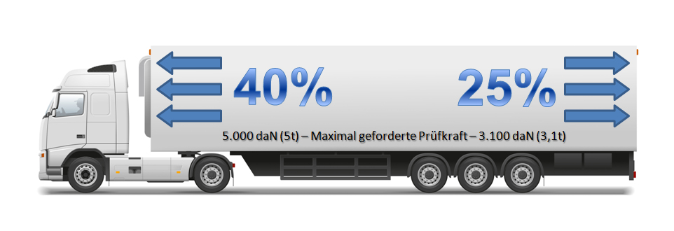
Weight carrying capacity

Slide 5
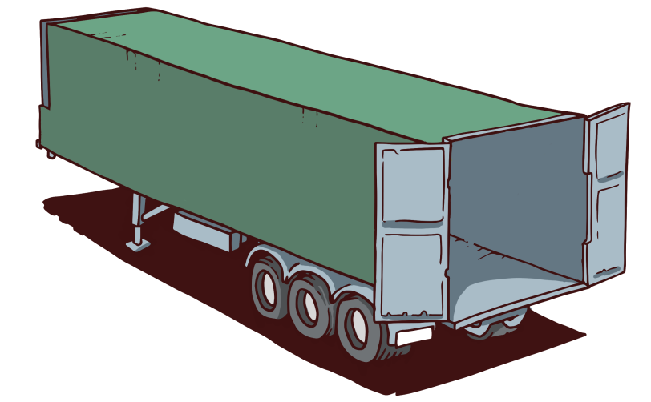

Box

Slide 6
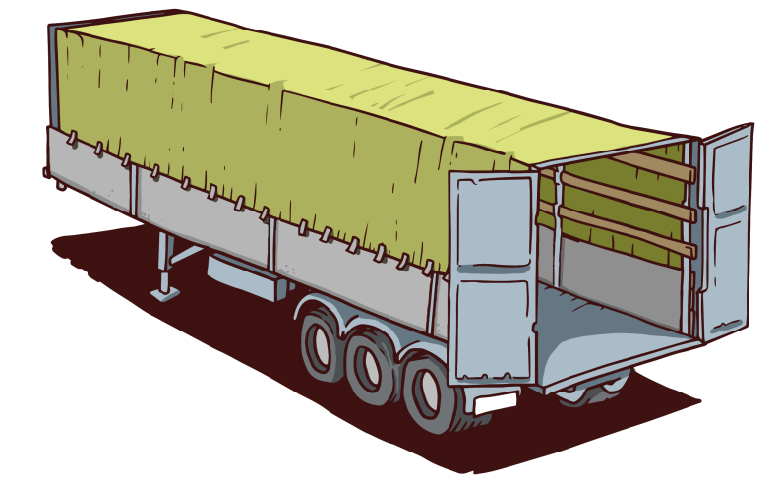
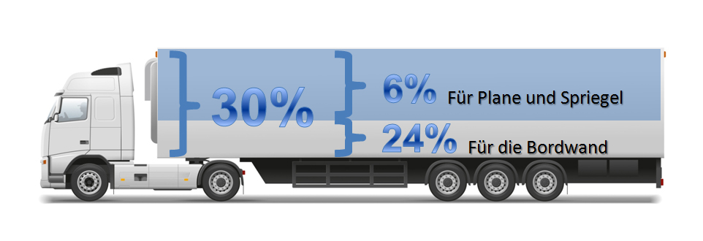
Cover/ stake

Slide 7
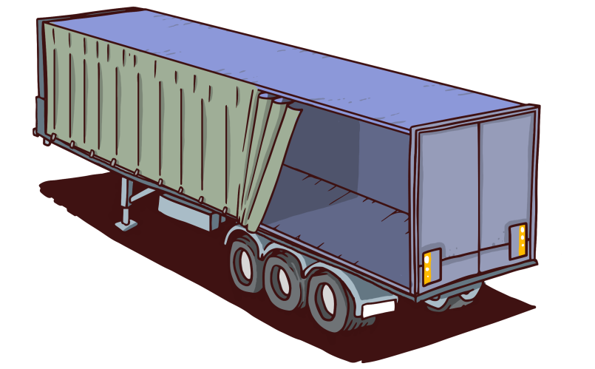

Curtainsider

Slide 8
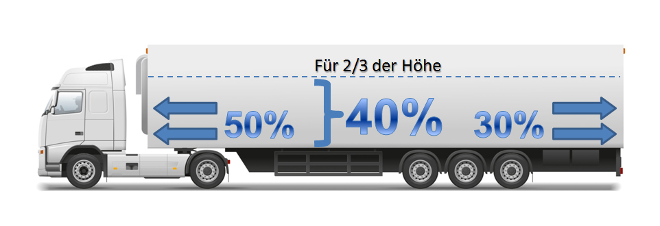
Curtensider
„Code XL“
nach DIN EN 12642

Slide 9
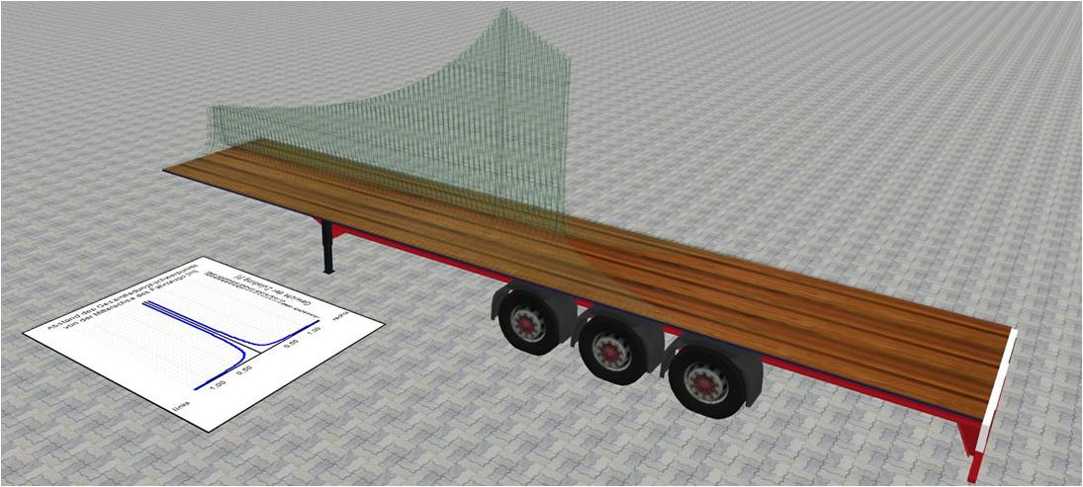
Load distribution
Source: LVP v4.0

Slide 10
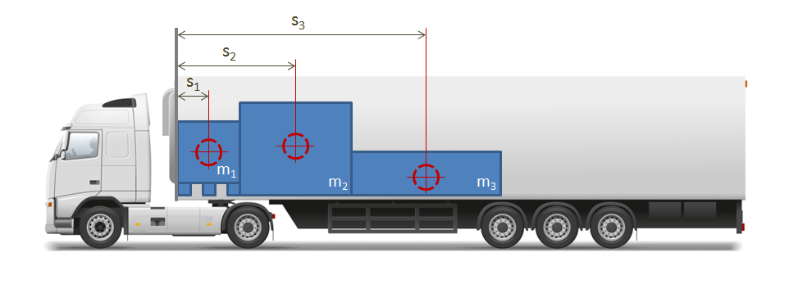
Centre of gravity (s_{res})
S_{res} = -------------------
m₁ x S₁ + m₂ x S₂ + m₃ x S₃
m = Weight of the good (t)
m₁ + m₂ + m₃
S = Centre of gravity to front wall (m)

Slide 11

Sample calculation
„Centre of gravity of
different pieces of cargo“
s₃
s₂
m₁ = 2.000 kg
2.000 kg
2.000 kg
S₁ = 0,6 m
0,6 m
s₁
m₂ = 5.000 kg
5.000 kg
5.000 kg
S₂ = 2,4 m
2,4 m
m₃ = 3.000 kg
3.000 kg
3.000 kg
S₃ = 5,1 m
m₁
5,1 m
m₂
m₃
1,2m
2,4m
3,0m
1.200 kg/m
28.500 kg/m
2,85 m
12.000 kg/m
15.300 kg/m
m₁ x S₁ + m₂ x S₂ + m₃ x S₃
S_{res} =
10.000 kg
m₁ + m₂ + m₃

Slide 12
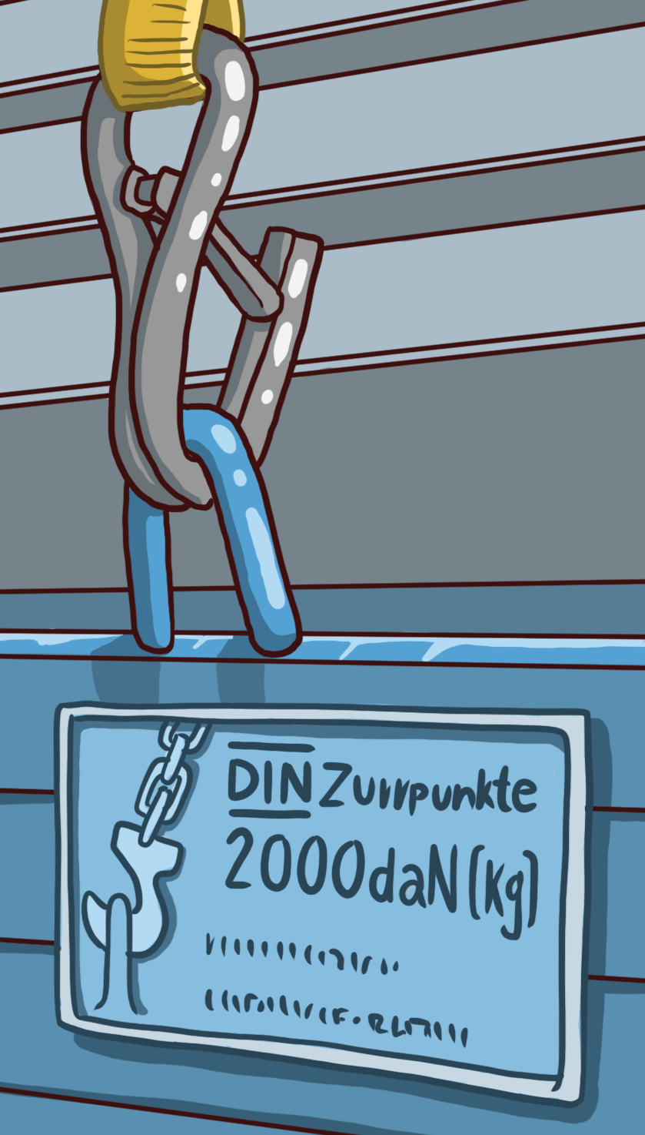
Lashing points

Slide 13
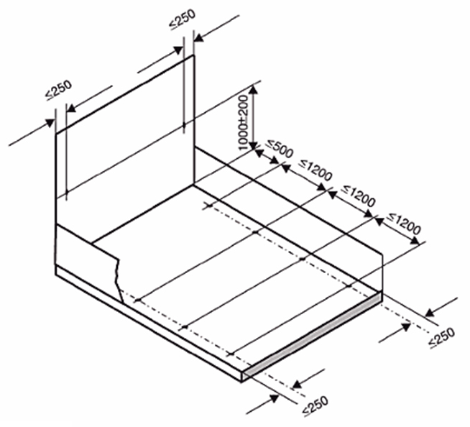
Number of lashing points

Slide 14
Labelling of lashing points
Lashing point label based on DIN EN 12640
Lashing point label incl. Handling instructions
Lashing point label incl. Handling instructions

Slide 15


Weight carrying capacity of lashing points
800 daN
2.000 daN
3,5 – 7,5 t
More than 12 t
1.000 daN
1.000 daN
7,5 - 12 t
Lashing point
front wall

Slide 16

www.project-ICTDRV.eu
Preparing and updating professional drivers‘ skills and
competences with multimedia-based learning.

