Slide 1
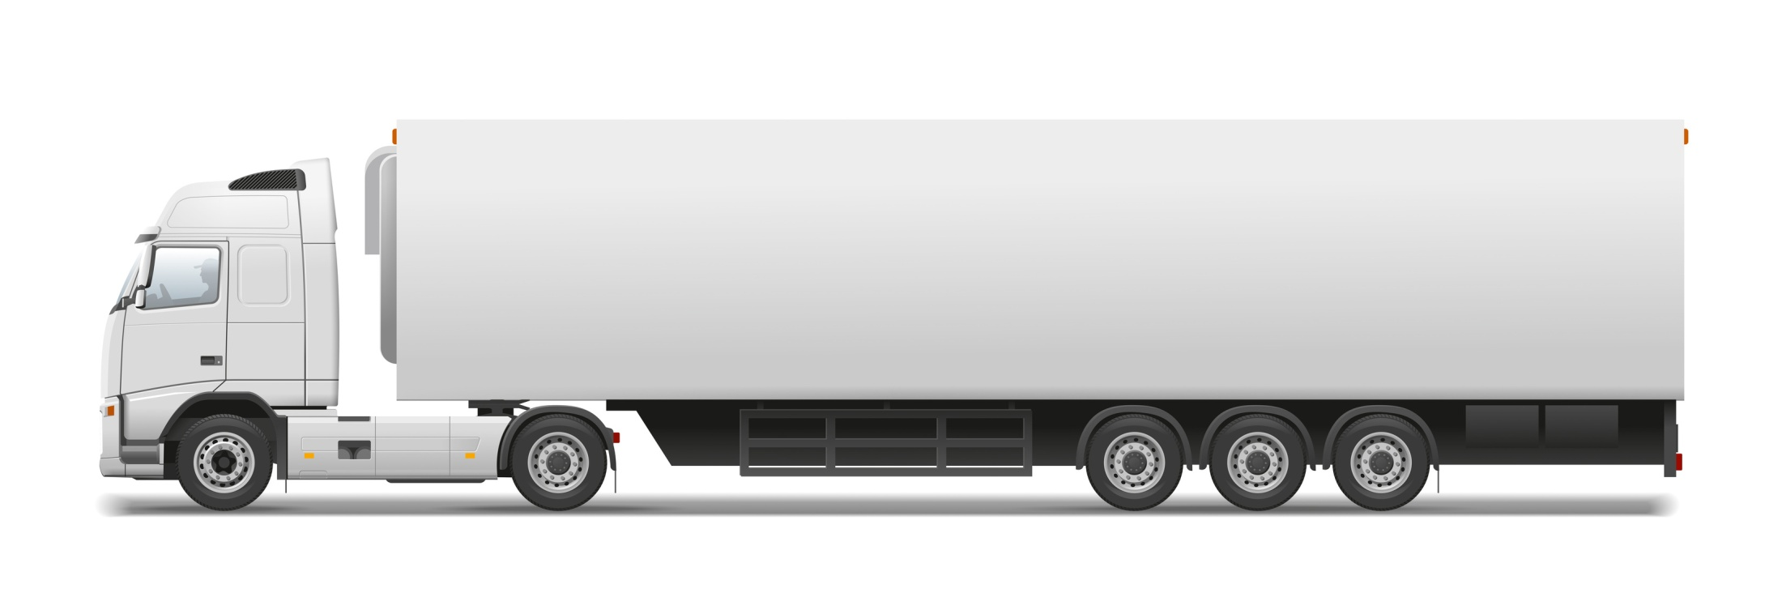
40%
25%
5.000 daN (5t) – Max. necessary proof load – 3.100 daN (3,1t)

Slide 2
30%
For the whole height

Slide 3
30%
6%
For curtain and tarp hoops
24%
For platform panels

Slide 4
0%

Slide 5
For 2/3 of height
40%
50%
30%

Slide 6
s₃
s₂
s₁
m₁
m₂
m₃

